Slide 1
Thermodynamics for Cryogenics
Ram C. Dhuley (updates by Greg Tatkowski)
USPAS – Cryogenic Engineering
February 3 – February 7, 2025

Slide 2
Why study thermodynamics in the context of cryogenics?
Accelerator helium cryogenic systems produce large cooling power at extremely low temperatures (for example, ~several kW @ 2 K)
consume huge amount of electrical power (~MW level)
involve large scale interconversion of heat and mechanical power (gas compression/expansion).
To save on cost, the cryogenic machinery and processes must be designed with good efficiency of energy interconversion.
Thermodynamics deals with the relations between heat and other forms of energy such as mechanical, electrical, or chemical energy
mathematical framework for analyzing processes and energy forms
‘laws’ that set theoretical limits on process efficiencies.

Slide 3
Goals
Revise important definitions in thermodynamics
– system and surrounding, state properties,
derived properties, processes
Revise laws of thermodynamics and learn how to apply them to cryogenic systems
Learn about ‘ideal’ thermodynamic processes and their application to cryogenic systems
Prepare background for analyzing real-world helium liquefaction and refrigeration cycles

Slide 4
Definitions
Thermodynamic system is the specified region in which heat, work, and mass transfer are being studied.
Surrounding is everything else other than the system.
Thermodynamic boundary is a surface separating the system from the surrounding.
Boundary
System
Surrounding

Slide 5
Definitions (continued)
Types of thermodynamic systems
Isolated system has no exchange of mass or energy with its surrounding
Closed system exchanges heat but not mass
Open system exchanges both heat and mass with its surrounding
Thermodynamic State
Thermodynamic state is the condition of the system at a given time, defined by ‘state’ properties
  More details on next slides
Two state properties define a state of a “homogenous” system
Usually, three state properties are needed to define a state of a non-homogenous system (example: two phase, mixture)

Slide 6
Common state properties
T – temperature
P – pressure (force per unit area)
V – volume of the closed system
v – specific volume (inverse of density)
U – internal energy of the closed system
u – internal energy per unit mass (specific internal energy)
H – enthalpy = U + PV
h – enthalpy per unit mass (specific enthalpy)
S – entropy
s – entropy per unit mass (specific entropy)

Slide 7
Common derived properties
Some important thermodynamic properties are defined from others, such as the heat capacities, c_{v} , and c_{P}
Since typically two properties define the state of the pure fluid in thermodynamics, equations generally have two independent variables
Derivatives then are partial derivatives with respect to one independent variable with the other held constant

Slide 8
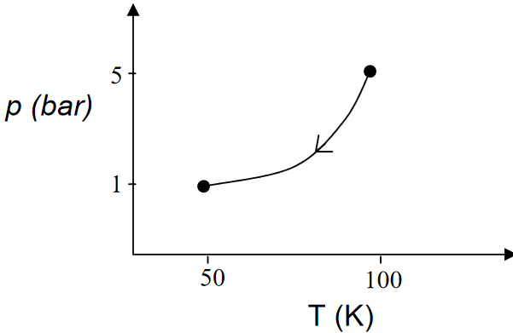
Thermodynamic Path and Process
Thermodynamic Path
A path is series of intermediate states that a system takes while going from one (initial) state to another (final) state
Thermodynamic Process
Process defines the type of thermodynamic path taken by the system while going from initial to final state
  Isothermal – temperature remained constant
  Isobaric – pressure remained constant
  Isochoric – volume remained constant
  Isentropic – entropy remained constant
  Isenthalpic – enthalpy remained constant

Slide 9
Equation of state
Equation of state (EOS) is a relation between the state parameters that a system obeys while changing from one state to another.
An example is Ideal gas EOS, given by where R is universal gas constant/gas molar mass
good approximation for gases at low pressure and
high temperature (far away from critical p and T)
‘ideality’ can be evaluated from compressibility factor
Z = pv/RT (an ideal gas has Z = 1)
Several EOS have been formulated for real gases, one example is the Van der Waals EOS.

Slide 10
Compressibility factor Z for helium
~5 % non-ideality
Pv/RT
300 K
~1 % non-ideality
20 K
<2 % non-ideality
Pressure (atm)
What does this practically mean? Helium has <10% non-ideality down to 8 K

Slide 11
More about ideal gases
The internal energy of an ideal gas is a function of temperature alone, where c_{v} is constant
Since h = u +Pv, so h = u + RT for an ideal gas, enthalpy is also a function of temperature alone for an ideal gas, where c_{p} is constant.

Slide 12
Reversible process
A theoretical process in which state of a system is changed in a series of infinitesimal steps such that at every step the system holds equilibrium with its surrounding. At every step, the change can be “undone” to restore the system to its prior state.
In other words, a reversible process is one where a system’s final state can be reversed to its initial state without leaving any trace on the surroundings.
In the context of refrigeration/cryogenics, a reversible process
consumes the least amount of mechanical power (work) for compression
produces maximum mechanical power (work) during expansion

Slide 13
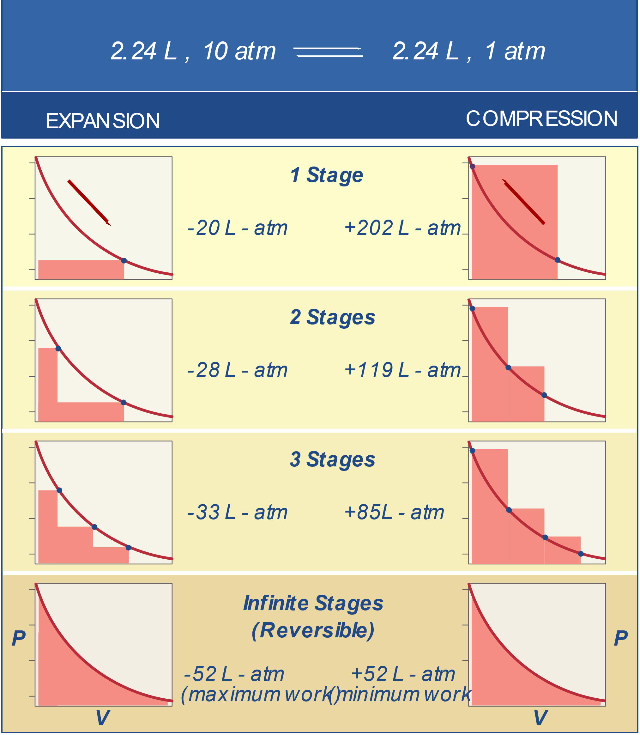
Reversible process
Figure notes:
Pressure vs specific volume
SALMON areas = Work
Process done in large, discreet steps
(irreversible)
Process done in infinitesimal steps
(reversible)

Slide 14
The laws of thermodynamics
Zeroth law – Two systems in thermal equilibrium with a third system are in thermal equilibrium with each other
First law – The total energy of a system is conserved during a thermodynamic process
Second law – The entropy of a system increases in all real processes and is conserved in reversible processes
Third law – The entropy of a pure substance in complete thermodynamic equilibrium becomes zero at a temperature of absolute zero

Slide 15
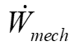

The laws of thermodynamics
Boundary
First law:
Second law:
with
Notes:
Time derivative terms are zero for steady state processes
Mass flow terms are zero for closed systems
Sign convention: Inward = positive, outward = negative

Slide 16
Isothermal compression
Reversible, constant temperature compression - requires the least amount of mechanical work to pressurize a fluid
Sets an upper limit on the efficiency of compression, aka ‘isothermal efficiency’
Let’s apply laws of thermodynamics to determine work of isothermal compression at steady state
Neglect changes in kinetic and potential energy
Assume ideal gas, Pv = RT
Isothermal compressor
First law:
=0 for ideal gas
Second law:
=0 for a reversible process
Combine, re-arrange,
and use ideal gas EOS:

Slide 17
Isothermal compression
An example from Fermilab
The second stage screw compressor at Fermilab’s MTF compresses 200 grams/sec helium from about 2.6 bar to 15 bar
For helium R = 2.078 J/gK, so the ideal work at 300 K is
In reality, the typical energy consumption of this particular screw compressor is 800 HP (600 kW), therefore the isothermal efficiency is roughly 37%

Slide 18
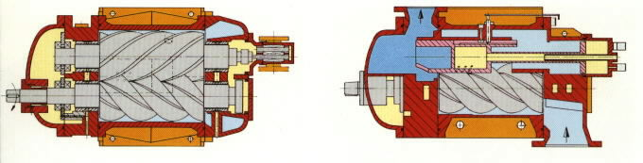
A real helium compressor
Oil-flooded screw compressors are now standard
A typical pressure ratio is about 4:1, so two stages are used in a typical helium plant to get a 15:1 to 20 :1 pressure ratio

Slide 19
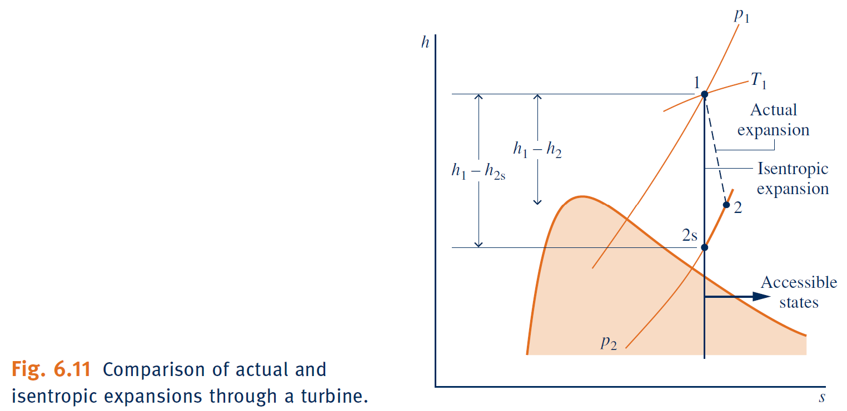
Isentropic expansion
Reversible expansion of a fluid without exchange of heat
The expansion produces mechanical work at the expense of enthalpy loss, which results in cooling
Produces maximum change in enthalpy and sets an upper limit on the efficiency of cooling via expansion, aka ‘isentropic efficiency’
Figure on right M. J. Moran, et. al., Fundamentals of Engineering Thermodynamics (2014), pg. 332
Let’s apply laws of thermodynamics to determine work of isentropic expansion at steady state
Neglect changes in kinetic and potential energy
Assume ideal gas, Pv = RT
Isentropic expander
First law:
=0 for isentropic process
Second law: each term is identically zero
Rearrange first law and use ideal gas EOS:

Slide 20
Isentropic expansion
Isentropic efficiency
Isentropic expansion efficiency is defined as
where Δh = h_{in} – h_{out}
Δh_{real} will always be less than Δh_{isentropc} so efficiency will be less than 100%
For real expanders, 65% to 85%

Slide 21
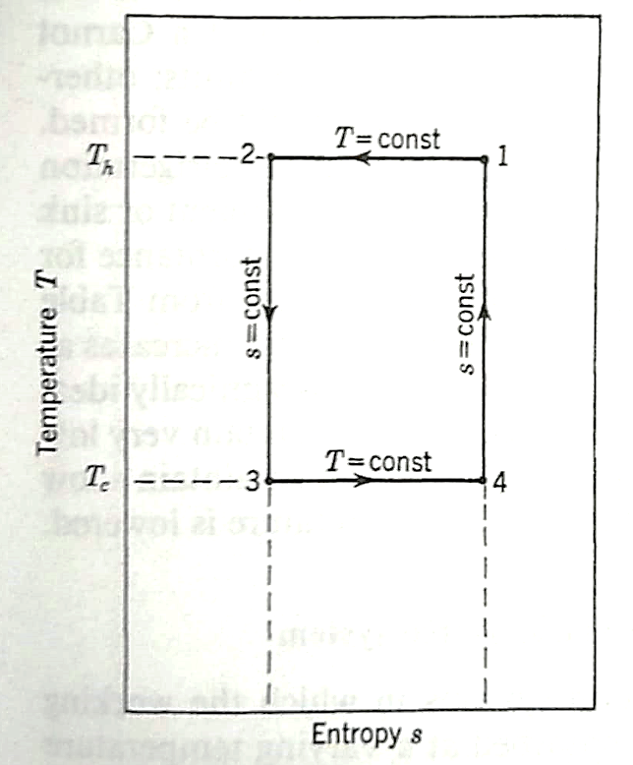
Thermodynamically ideal refrigerator
Type 1: Refrigeration load is isothermal (constant T)
The medium to be cooled is at constant temperature
Processes:
1 -> 2 – isothermal compression
2 -> 3 – isentropic expansion
3 -> 4 – isothermal heat absorption (ref. load)
4 -> 1 – isentropic compression
Apply first law to the entire cycle:
Cyclic process:
Net work input:
Refrigeration power:

Slide 22
Thermodynamically ideal refrigerator
Type 1: Refrigeration load is isothermal (constant T)
The medium to be cooled is at constant temperature
Coefficient of performance (COP):
Defined as the ratio of refrigeration load to net
input mechanical work (i.e., benefit/cost)
The COP of an ideal gas, ideal isothermal load refrigerator:
depends only on ambient and load temperatures
does not depend on the fluid or its pressure
represents the highest refrigeration power one can get for a given work input
Eg:
for and
At least 75 W (=1/0.013) of mechanical power input is needed at 300 K to obtain 1 W refrigeration at 4 K

Slide 23
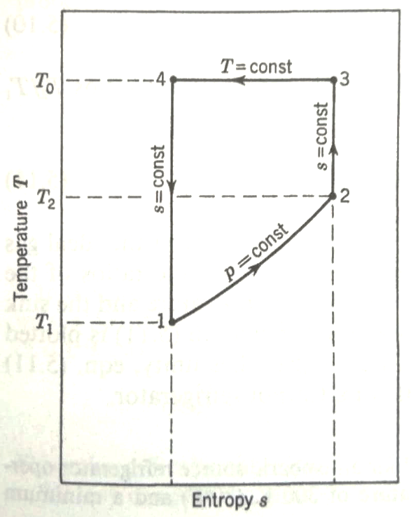
Thermodynamically ideal refrigerator
Type 2: Refrigeration load is non-isothermal
Temperature of the medium increases as refrigeration load is absorbed
Typically, the pressure remains constant (isobaric ref. load)
Processes:
1 -> 2 – isobaric heat absorption (ref. load)
2 -> 3 – isentropic compression
3 -> 4 – isothermal compression
4 -> 1 – isentropic expansion
Apply first law to the entire cycle:
Cyclic process:
Net work input:

Slide 24
Thermodynamically ideal refrigerator
Type 2: Refrigeration load is non-isothermal
Temperature of the medium increases as refrigeration load is absorbed
Typically, the pressure remains constant (isobaric ref. load)
Apply first law to the entire cycle:
Refrigeration power:
Coefficient of performance (COP):
If the fluid is an ideal gas,

Slide 25
Isenthalpic expansion
A simple, commonly used method for cooling
Expansion through a valve does no work, and neither adds nor removes energy
  Process is isenthalpic
Enthalpy of the perfect gas is a function of temperature alone
  Isenthalpic process of perfect gas
  does not change the temperature
Real fluids may change temperature via an isenthalpic expansion
  Joule-Thomson effect
For ideal gases

Slide 26
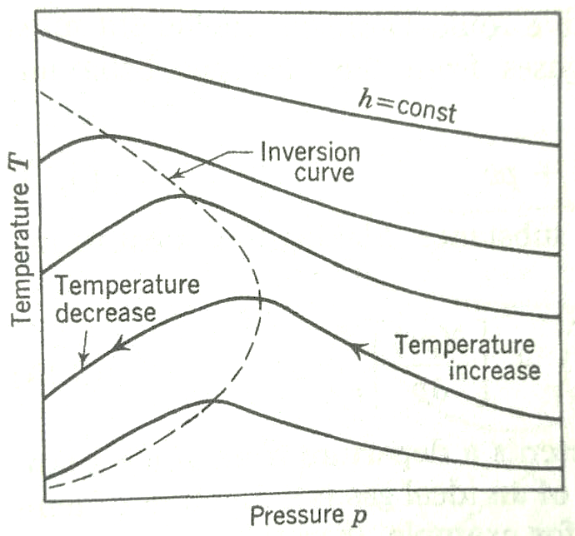
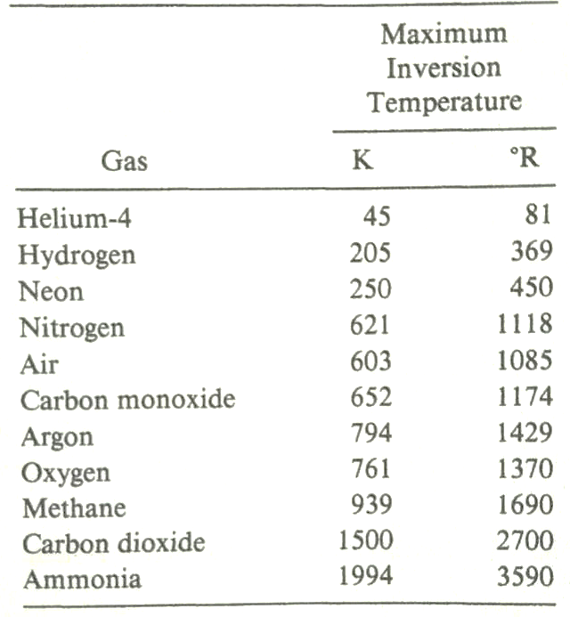
Isenthalpic expansion
Joule Thompson expansion
In real fluids, including helium, isenthalpic expansion may provide temperature drop
  Starting P and T need to be on the ‘left’ side of inversion curve where (dP/dT)|_{h} > 0
Joule-Thomson expansion through a valve is said to be through a “J-T valve”
  Not as efficient of isentropic expansion
  But very convenient and easy (no moving parts)
  Used frequently as the final expansion stage in real helium refrigerators, liquefiers

Slide 27
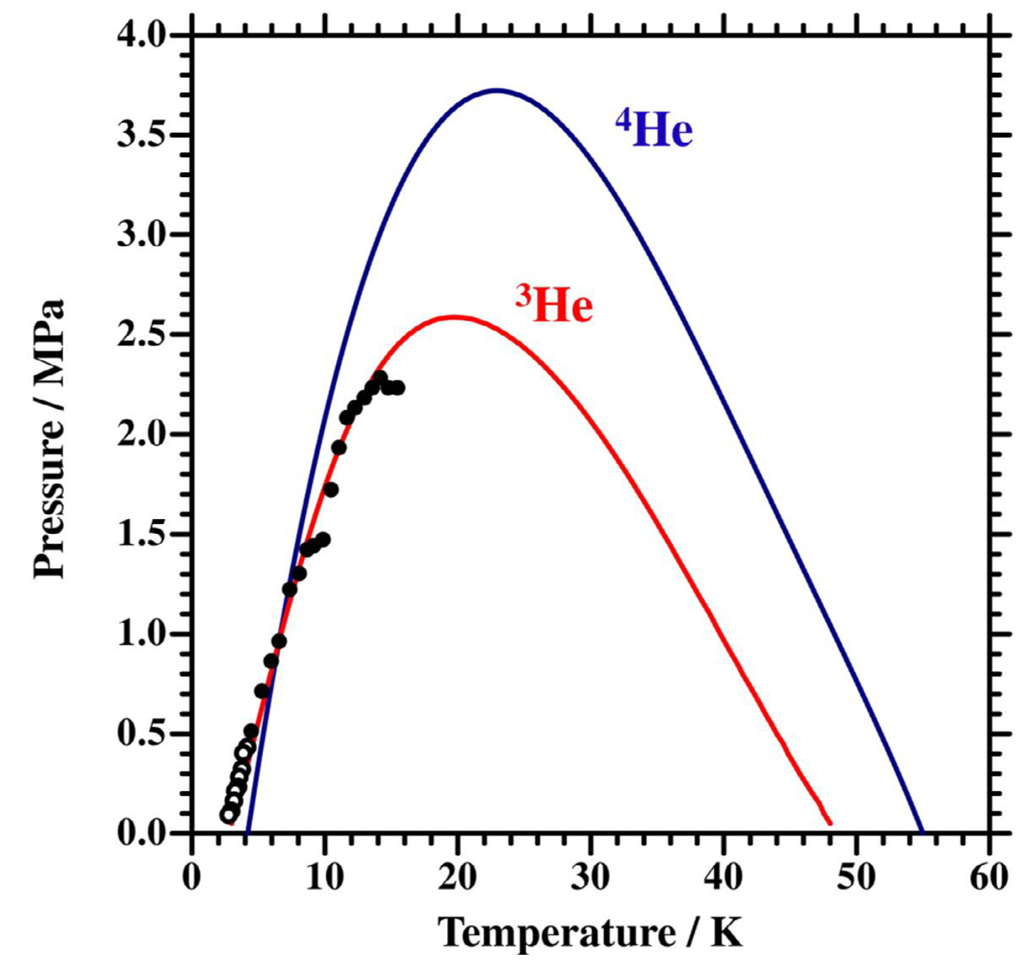
Isenthalpic expansion
Source: K. Tada, The Full Range Joule-Thomson Inversion Curve of Helium-3, International Journal of Refrigeration 127 (2021) 157–164

Slide 28
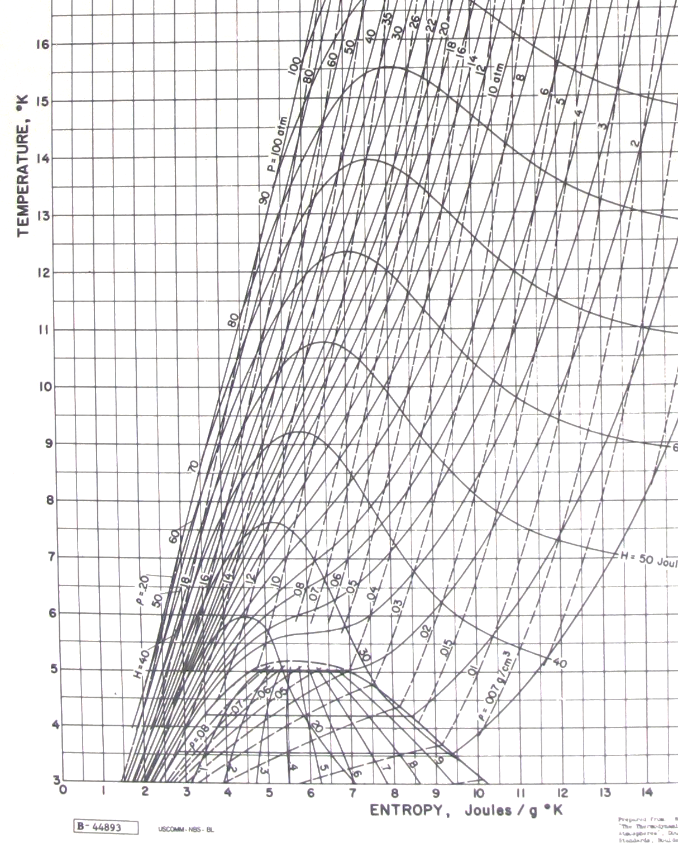
Temperature entropy chart for helium
Source of state properties
for thermodynamic analyses
Isothermal compression
Isentropic
expansion
Isenthalpic
expansion
H = constant
P = constant
2-phase dome
ρ = constant

Slide 29
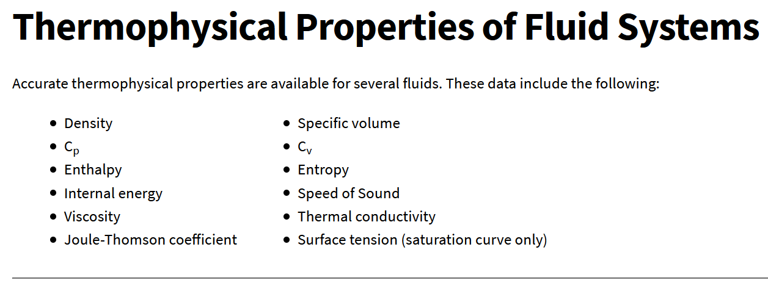
NIST Thermophysical Properties of Fluid Systems (https://webbook.nist.gov/chemistry/fluid/)
Source of state properties
for thermodynamic analyses

Slide 30

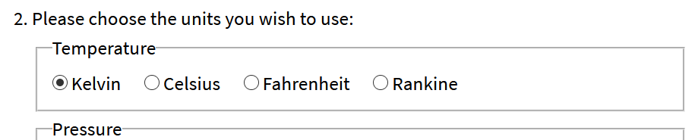
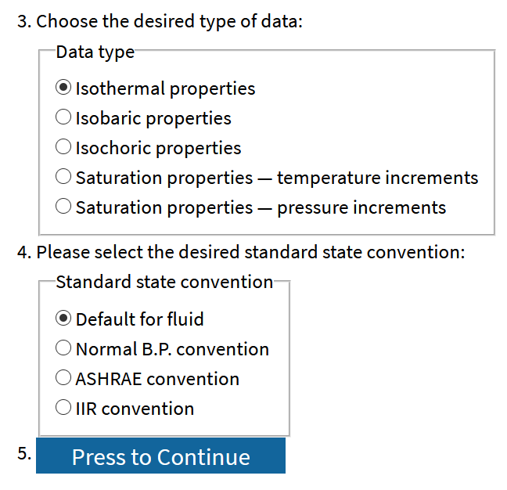
How to use the NIST webbook?

Slide 31
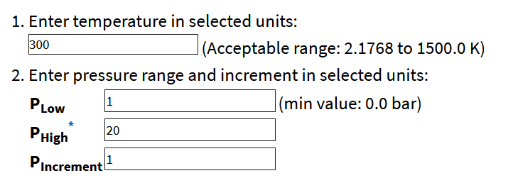
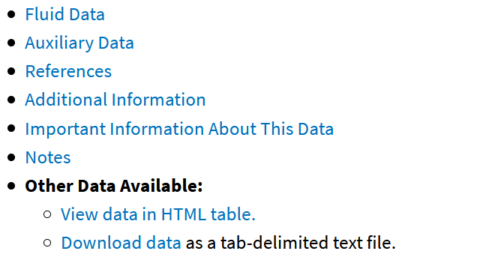
How to use the NIST webbook?

Slide 32
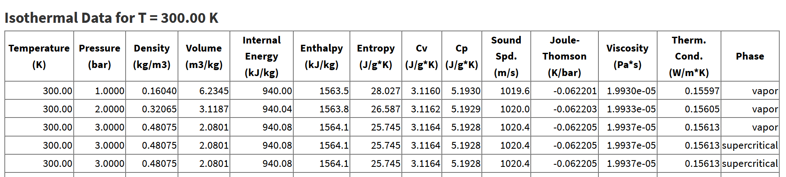
How to use the NIST webbook?
Data from this table can be copied to a spreadsheet or exported
as a tab-delimited file.

Slide 33
References
R. Barron, “Cryogenic Systems”, Oxford University Press; 2nd edition (June 13, 1985).
NIST database: Thermophysical Properties of Fluid Systems, https://webbook.nist.gov/chemistry/fluid/.
A nice explanation of reversible processes - https://chem.libretexts.org/Bookshelves/General_Chemistry/Map%3A_Principles_of_Modern_Chemistry_(Oxtoby_et_al.)/Unit_4%3A_Equilibrium_in_Chemical_Reactions/13%3A_Spontaneous_Processes_and_Thermodynamic_Equilibrium/13.4%3A_Entropy_Changes_in_Reversible_Processes

